Slide 1

Retail Sales & Profitability Analysis
Ayush Rajput
Data Analytics Project
Business Intelligence Dashboard Project
Tools: PostgreSQL | SQL | Power BI

Slide 2
Business Problem Statement
The retail company was facing challenges in:
Understanding profit fluctuations
Identifying low-performing regions
Managing high discount losses
Tracking category-wise profitability
Monitoring customer segment performance
Goal:
To use data analytics and dashboarding to identify business problems and generate actionable insights.

Slide 3
End-to-End Data Analytics Workflow
Raw CSV Data
↓
PostgreSQL Database
↓
SQL Data Analysis
↓
Power BI Dashboard
↓
Business Insights & Recommendations
Small explanation
Data imported into PostgreSQL
SQL used for business analysis
Power BI used for visualization
Insights generated for decision-making

Slide 4
Dataset Overview
Metric | Value
Total Records | 9,994
Date Range | 2014–2017
Regions | 4
Categories | 3
Segments | 3
The dataset contains:
Sales
Profit
Discount
Customer segment
Product categories
Regional transaction data

Slide 5
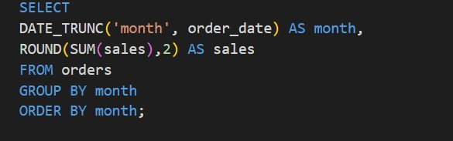
SQL-Based Business Analysis
Total Sales Calculation
Profit Margin Analysis
Region-wise Profitability
Category Performance
Discount Impact Analysis
Segment Analysis
Monthly Sales Trend

Slide 6
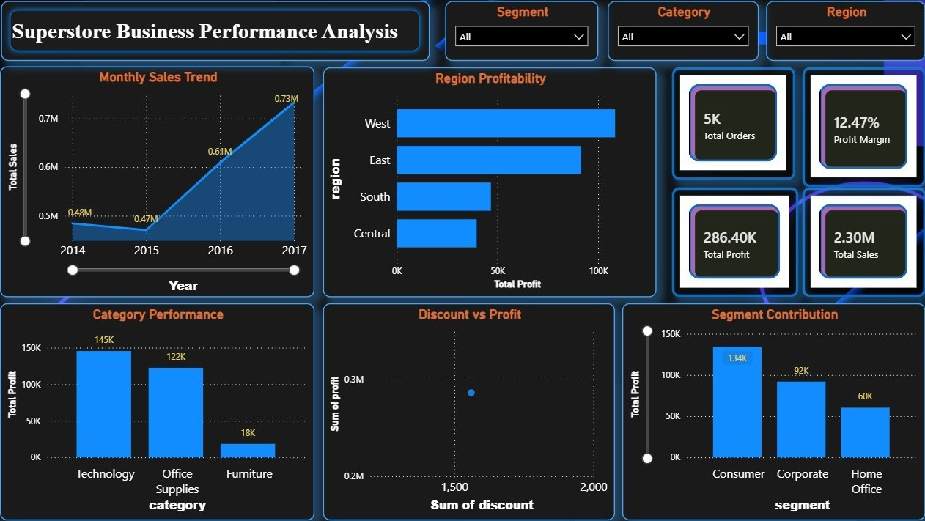
Interactive Power BI Dashboard
KPI monitoring
Dynamic filtering
Trend visualization
Profitability analysis
Interactive business exploration

Slide 7
Key Business Insights
Insight
Central region generated the lowest profitability.
Higher discounts significantly reduced profit margins.
Furniture category underperformed compared to Technology.
Consumer segment generated the highest profit contribution.
Technology category showed strongest overall performance.

Slide 8
Strategic Recommendations
Recommendations
Reduce excessive discounting strategy.
Improve operational performance in Central region.
Focus on high-profit product categories.
Strengthen retention strategy for Consumer customers.
Optimize pricing for low-performing furniture products.

Slide 9
Project Outcome & Learning
This project demonstrates:
SQL-based business analysis
Dashboard development
Data storytelling
Insight generation
Business decision support

Slide 10
This project helped improve practical skills in data analytics and business intelligence.
Thank You

